Slide 1
Git’n Pro with HTML/CSS

Slide 2
It’s Okay!
How do I do this again?
Flickr: welcometolearn

Slide 3
Admin Items

Slide 4
Where to Get Help
Review In Class Material (Exercises and Slides) in our class repo on Gitlab (https://oregon.bootcampcontent.com/Oregon_Coding_Bootcamp/UOPTL201904FSF3)
Re-Watch Class Videos on Panopto (the link for each video will be announced via https://bootcampspot.com/ after class going forward)
In Class Office Hours: 45 minutes before class, 30 minutes after
One-on-One Sessions: By Announcement through SSM
Contact Student Success: Anytime!

Slide 5
Where to Get Help
Practice, Practice, Practice!
Work Individually or in Groups
Explore and think about how you can use your new skills and bounce ideas off each other

Slide 6
Homework #1 - Assignment
Also, at this point everyone should have access to the class content and homework repository: https://oregon.bootcampcontent.com/Oregon_Coding_Bootcamp/UOPTL201904FSF3
Homework Assignment #1 is due April 13th

Slide 7
Today’s Class!

Slide 8
Today’s Objectives
Understand the importance of Git Version Control and of how to use it
Create GitHub Repositories, push code into them, and share with class
Make your own HTML documents
Learn to use some more common HTML tags
Add visual style to HTML using CSS

Slide 9
Know Thyself
If you are a complete beginner to HTML/CSS and Coding:
Continue getting comfortable with HTML
Be able to completely write a basic HTML document
Understand what CSS is, what it’s for, and how it works with HTML
Be able to use Git and GitHub to upload code
If you’ve had past exposure and have some experience with HTML:
Aim to build up your skills. Clear up any questions or confusions about HTML
Become knowledgeable about a wider range of HTML and CSS tags
Be able to selectively apply CSS to specific HTML elements
Be able to use Git and GitHub to upload code

Slide 10
What / Why Git?

Slide 11
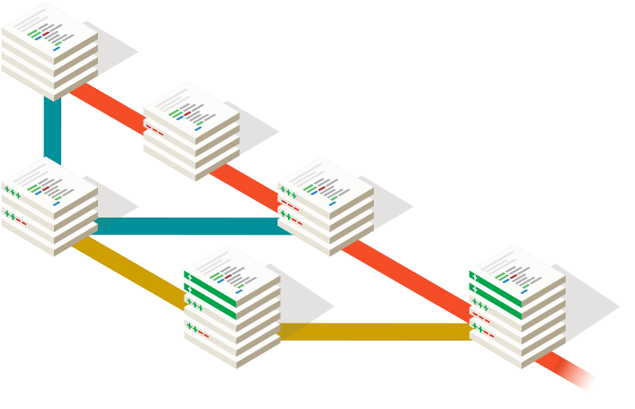
Collaborative Coding
Modern web development is highly collaborative.
Teams are often extremely large and separated across the country — or planet.
Apps sometimes comprise hundreds or even thousands of files.

Slide 12
Let’s Think About It…
What could go wrong?

Slide 13



The Group Project
Lesson:
You should use Version Control.
….and watch your teammates’ work
Through the Git, things you will see. Other branches. The future… the past…
…You will find only what you commit.

Slide 14
Version Control
Git Version Control:
Provides an organized system for managing code when multiple developers work on a project at the same time.
The Benefits of Git:
A process for resolving conflicts in code.
Version History.

Slide 15



The Group Project
Master Branch
Let’s say Yoda, Leia, and Han are all working on different branches for Google.
‘Branch’ = personal copy
Feature branch
Yoda - Maps branch
Leia - Translate branch
Han - Styles branch

Slide 16
The Group Project
If Leia, Yoda, and Han are all working on different branches, they can work separately without affecting each other’s code.
If Yoda added a Maps feature and Leia wants to use this new feature in his code, all Leia has to do is merge in the new version of Yoda’s branch into her own branch and keep coding! (This is much better than the alternative of copy and pasting files)
Always pass on what you have learned.

Slide 17
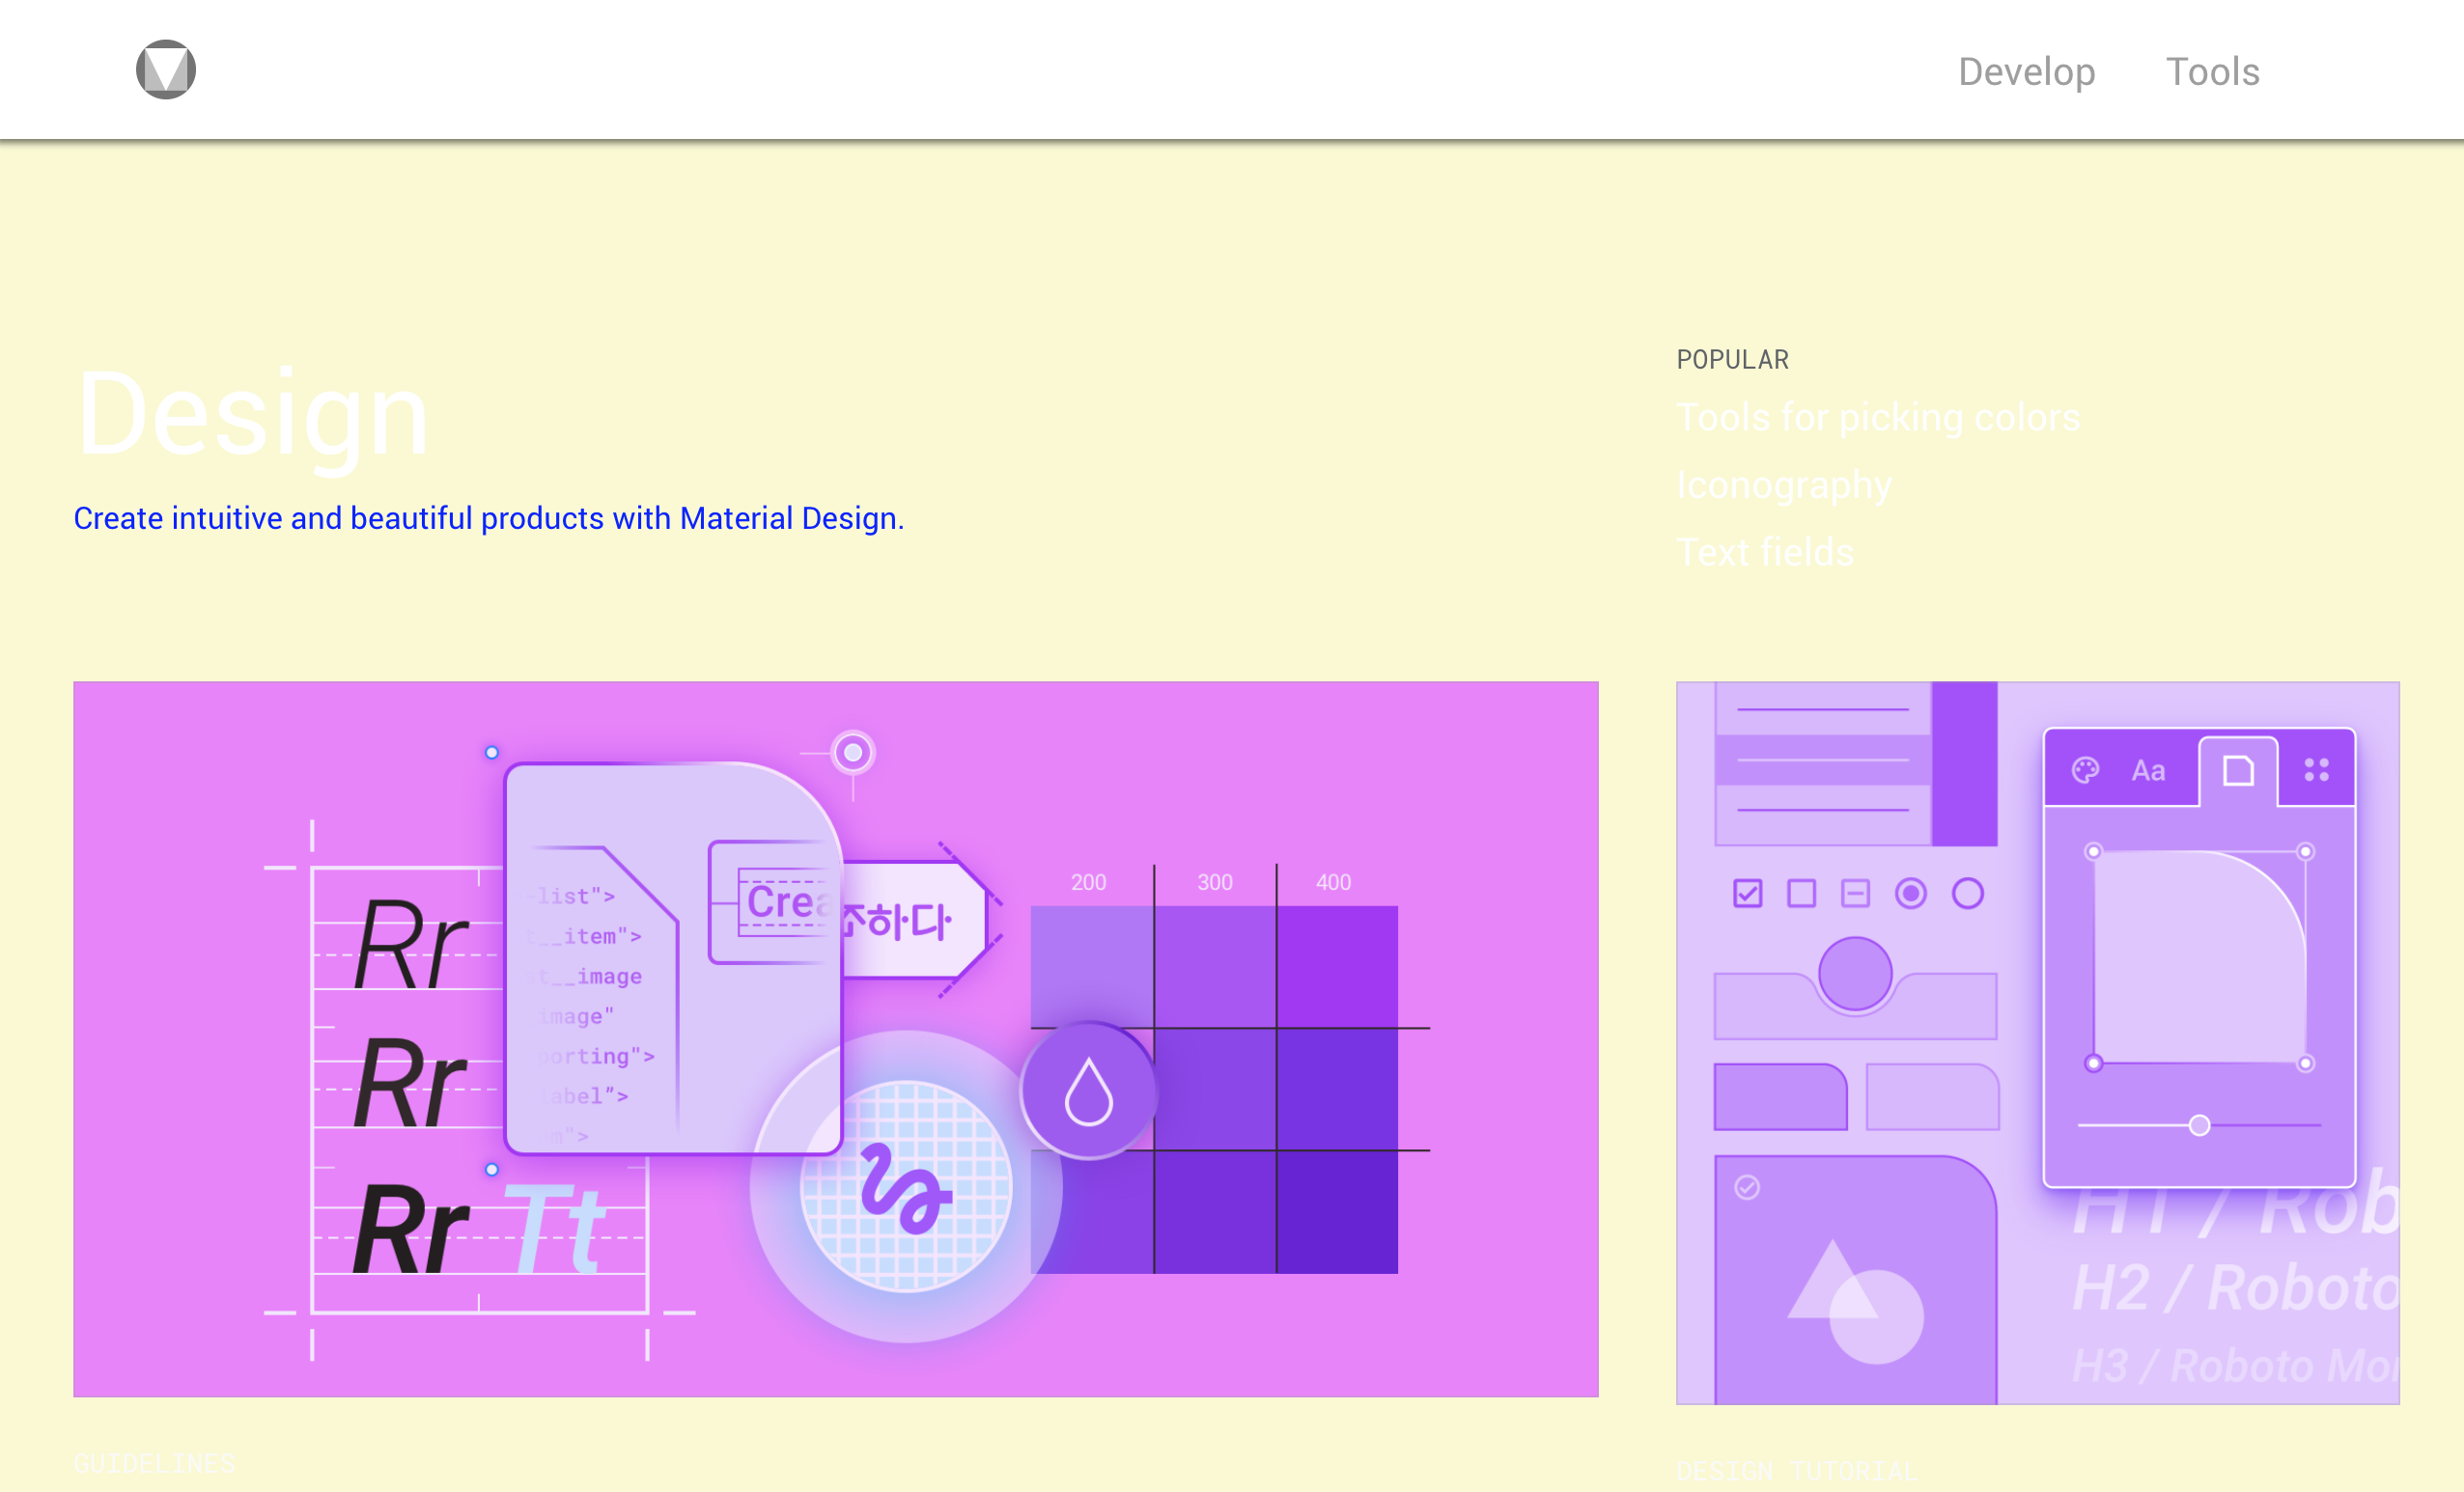

The Group Project
Let’s say Han was working on a site-wide change in styling, but one of his changes had unintended consequences on a page Leia was working on.
Instead of having to debug the problem while users stare at a broken page, Git makes it easy to instantly revert or “rollback” the mistake.
New Broken Version
Old Working Version
Revert

Slide 18
The Group Project
Lesson:
You should use Version Control!

Slide 19
Quick Activity!
Suggested Time: 3 min
Turn to your neighbor, and have one of you explain to the other:
The concept of version control.
Then the other should explain:
Two of the key advantages to using a version control system.

Slide 20

So… What’s this GitHub?
GitHub is a Web-Based hosting service to store code online.
It allows developers to pull (download) code or push (upload) code to the same repository (directory).
It also allows developers to view histories of code changes and to track issues.

Slide 21
So… What’s this GitHub?
GitHub also serves as a social network for developers and their code.
It allows developers to freely contribute to open source projects and discuss issues/features.

Slide 22
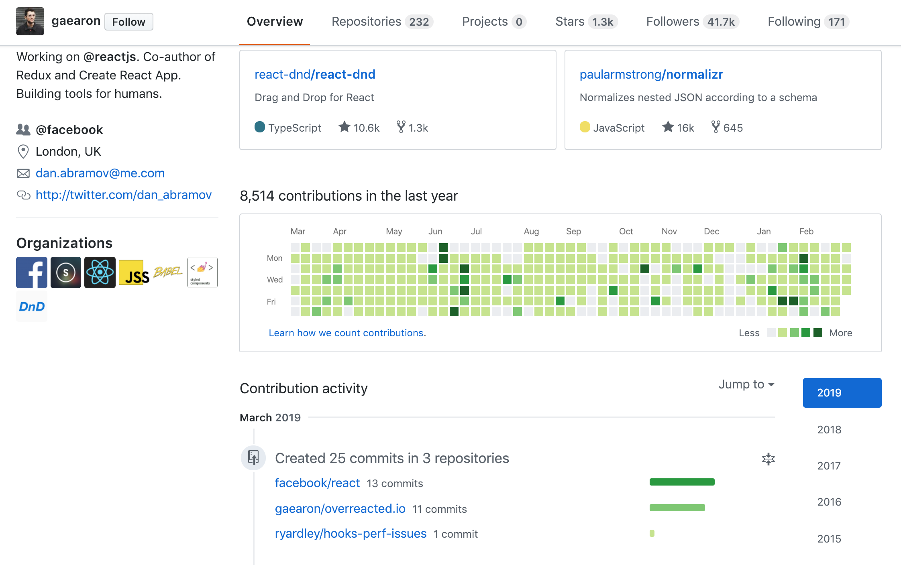
So… What’s this GitHub?
GitHub is a great way to showcase your work.
Hiring managers check GitHub activity and samples to evaluate candidates.
Seeing regular activity shows recruiters that you're continuously learning and developing.

Slide 23




To Sum It Up…
• Think of GitHub like Dropbox for Git. It serves as a backup for your repository and allows you to share your code with other people.
One big advantage GitHub has over a tool like DropBox is that there are many builtin tools to help with developers with collaboration.
• Remember, both Git and GitHub aren’t tied to specific programming languages. For our purposes, we’ve been using code examples, but they could just as easily be image files or PowerPoint presentations.
*Gitlab is similar to Github, but is another way to access and work on Git

Slide 24
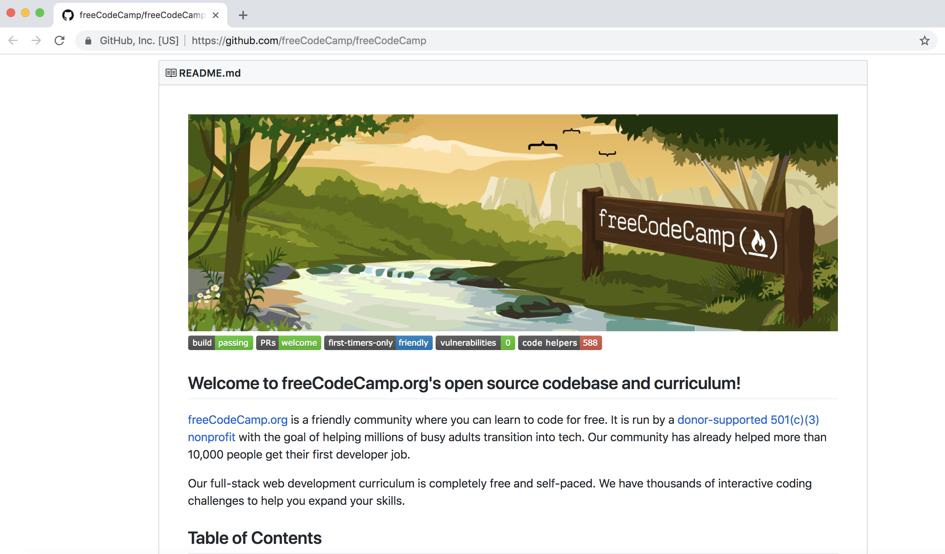
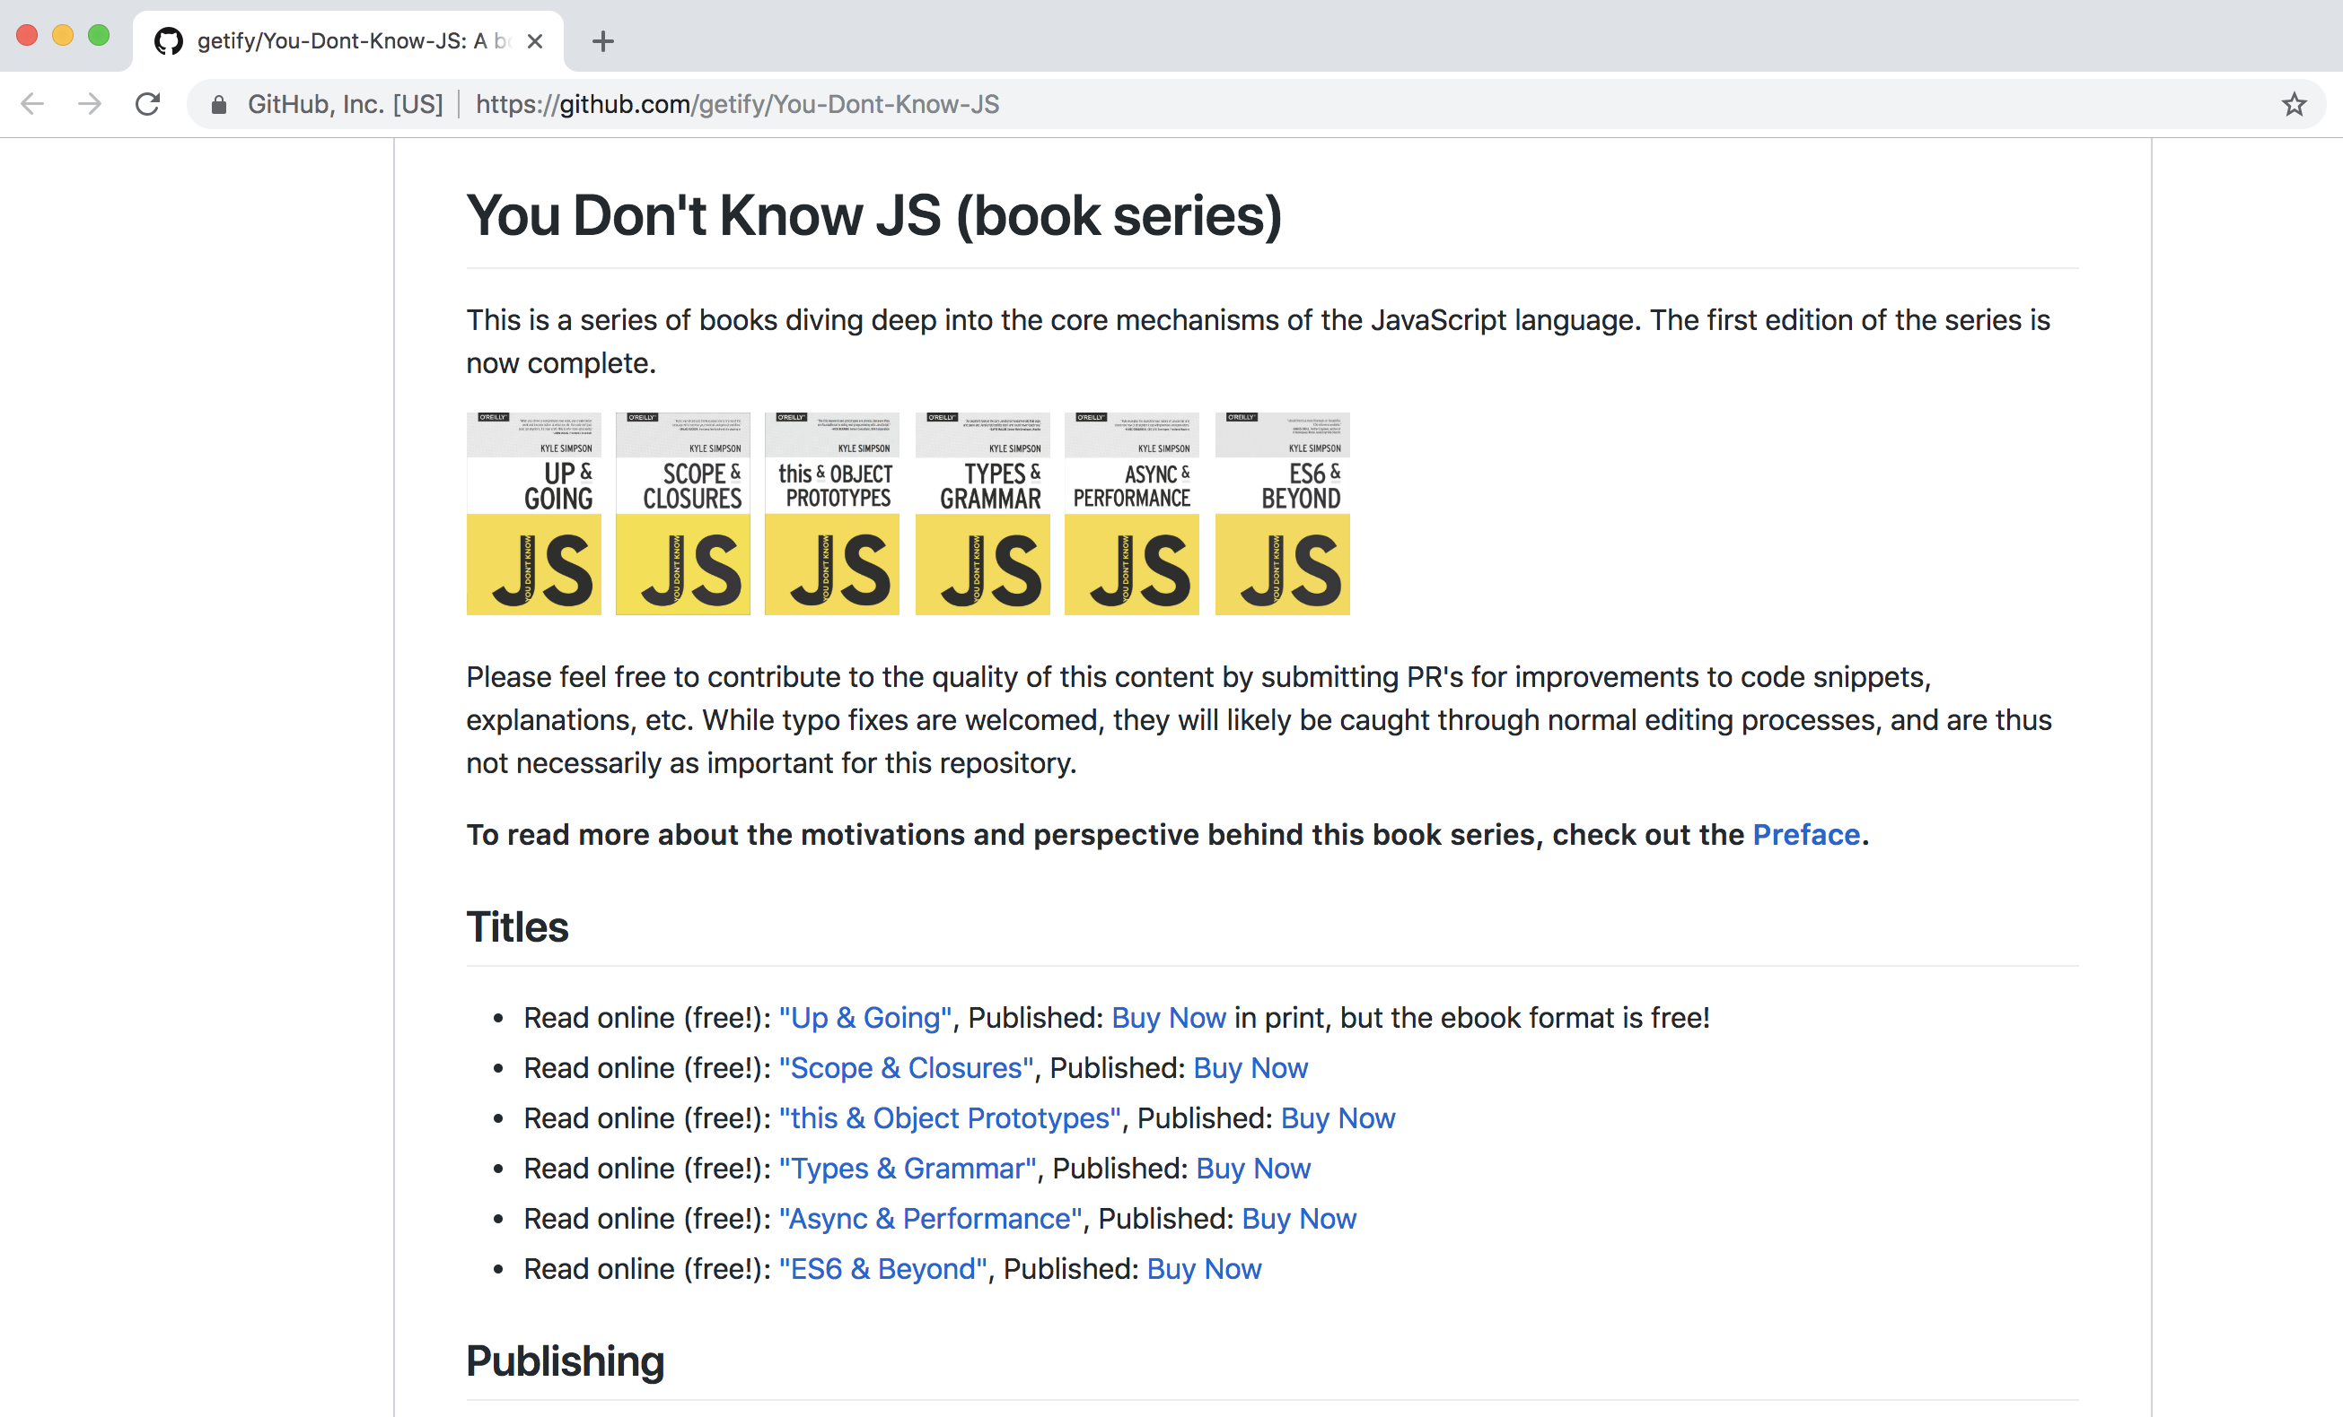
GitHub Examples
Repos…
Repos everywhere…

Slide 25
Get Started with Git

Slide 26
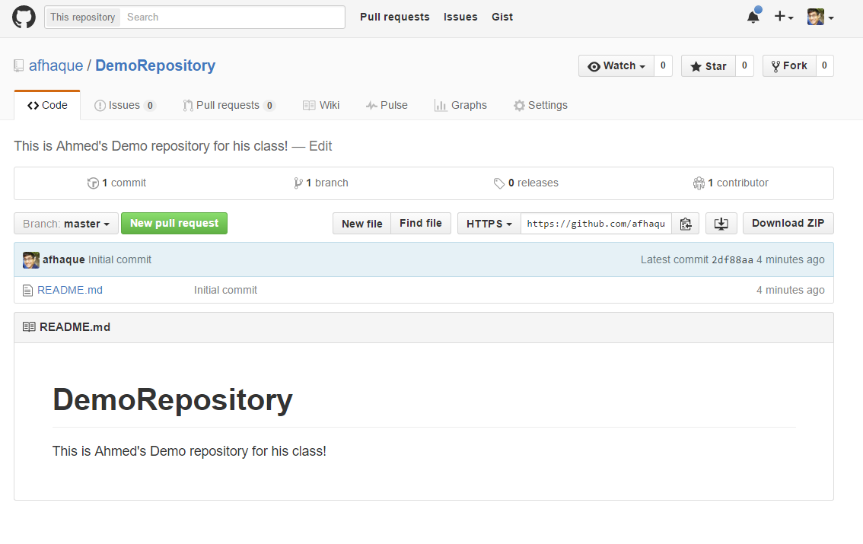
Instructor Git Demo!

Slide 27
Basic Git Commands
At its most basic, these are the five git commands to get started:
git clone
git add
git commit
git push
git pull

Slide 28
Basic Git Commands
At its most basic, these are the five git commands to get started:
git clone – copies an entire repo, while establishing a connection between a local and remote repo.
git add – tells git to track one or more files.
git commit – notes a change to the local repo.
git push – sends changes to a remote repo.
git pull – downloads freshest version of the repo (from a remote repository) into the local repo.

Slide 29
> YOUR TURN!
Activity: Git Add, Commit, Push | Suggested Time: 15 min
Assignment (Using GitHub and the command line):
Create a new public GitHub repository and name it whatever you like. Be sure to check the box for “initialize this repository with a README.”
Next, clone the repo to your local directory.
Then create an HTML file inside the local directory.
Add, Commit, and Push the code to GitHub.
Bonus:
Create a new public GitHub repository, and name it `zen-garden`.
Go to CSS Zen Garden (http://www.mezzoblue.com/zengarden/alldesigns/). Navigate to a few of the examples and choose a page that you like.
• Download the HTML/CSS, add it to your new repo, and style! (with CSS)
• Add, Commit, and Push the code to GitHub.

Slide 30
Git Workflow

Slide 31

The .git Folder
• When you cloned your repo, you might have noticed a hidden .git folder was created.
• This folder stores information about your repository, including a history of all changes, along with who made them.
This is what makes your local directory a repo, as opposed to a regular folder.

Slide 32
Git Workflow
In Git, there are four conceptual areas your code can be in.
Local
Repository
(HEAD)
Remote
Repository
Staging Area
(index)
Workspace
git add
git commit
git push

Slide 33


Workspace
The workspace is where you’re used to dealing with your files.
Any time you save a file, you’re replacing the old version of a file with a new one.
This step is referred to as Untracked since Git has no knowledge of your workspace.

Slide 34

Setting the Stage
• git add - Adds a file to the Staging Area.
This command takes an argument, which means we must provide the name of the file we want to add. Ex: git add myFile.md
Since we want to add all the files in our directory, we’ll give it the option -A. Ex: git add -A

Slide 35
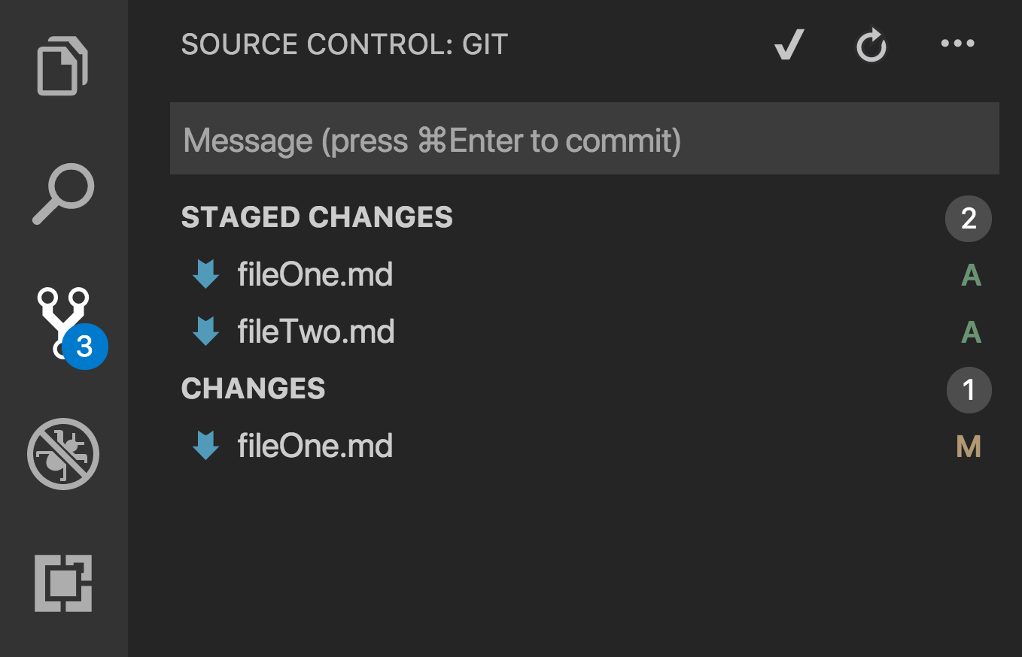
Setting the Stage Continued
These files have been staged with git add, but not committed.
This file has been changed (and saved) since it was staged.
We should probably run git add -A again.

Slide 36

Keeping It Local
To add files to the local repository, run git commit
This command takes the files from your staging area and adds them to the history kept in the .git folder.
git commit -m “Fixed a bug that caused a 403 error”

Slide 37


The Remote Repository
Lastly, we add our local repo to our remote repo with git push.
• Once things are pushed up to GitHub, GitHub will have a history of every change you’ve committed, along with any changes your teammates have pushed to the repo.
Remote Repo
Leia’s Local Repo
Luke’s New Repo
git push
git clone
Translate Branch
Translate Copy

Slide 38
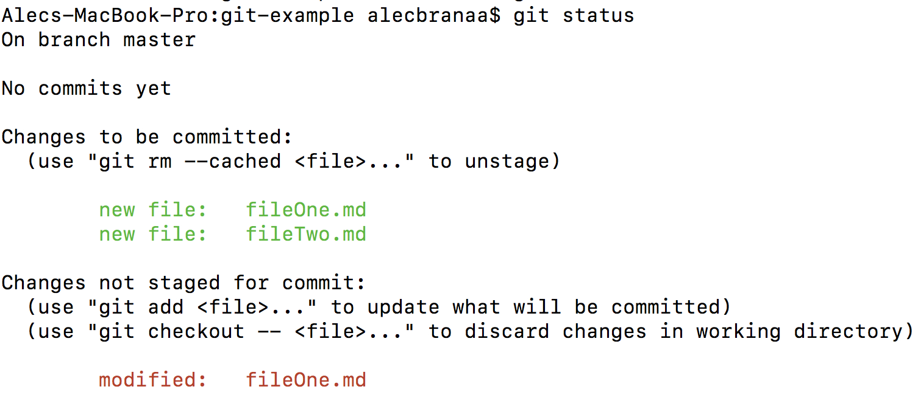
Still a Bit Lost? Never Worry!
• Remember that you will use these concepts every day.
It’s most important that you familiarize yourself with the 5 basic git commands.
• If you’re ever in the middle of making changes and want to see what step you’re at, run git status.

Slide 39

Still a Bit Lost? Never Worry!
Follow the handy pdf guide provided to you!
Practice a few times on your own before our next class.

Slide 40
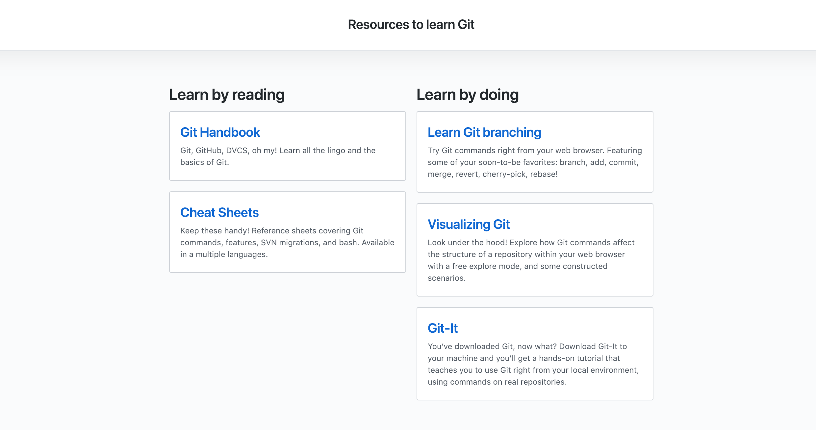
If You’re Still Lost… Here’s Some (Free) Resources
https://try.github.io/

Slide 41
HTML

Slide 42
HTML Syntax (Basic)
Content
<h1>
This is Mah House
</h1>
Opening Tag
Closing Tag

Slide 43
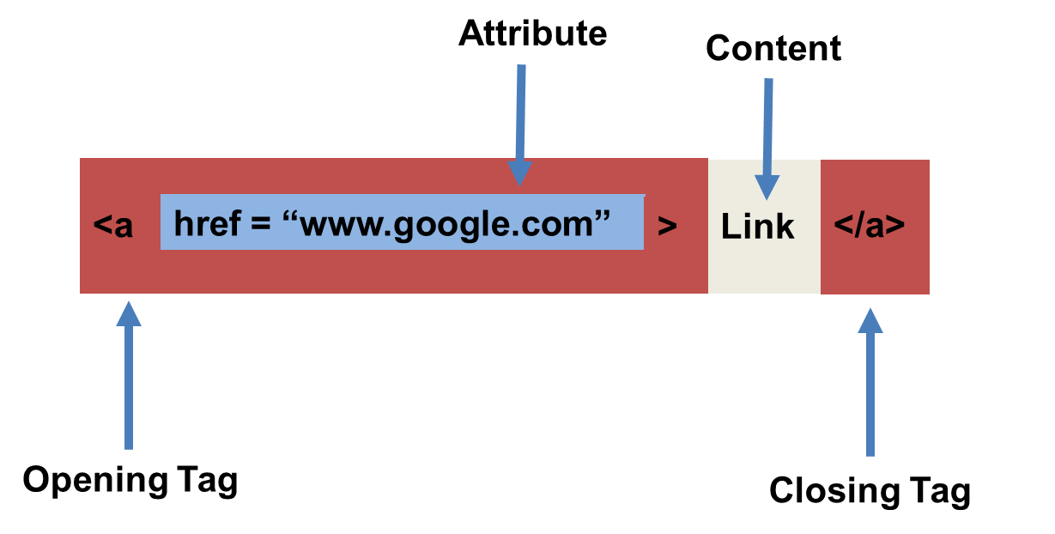
HTML Syntax (with Attribute)

Slide 44
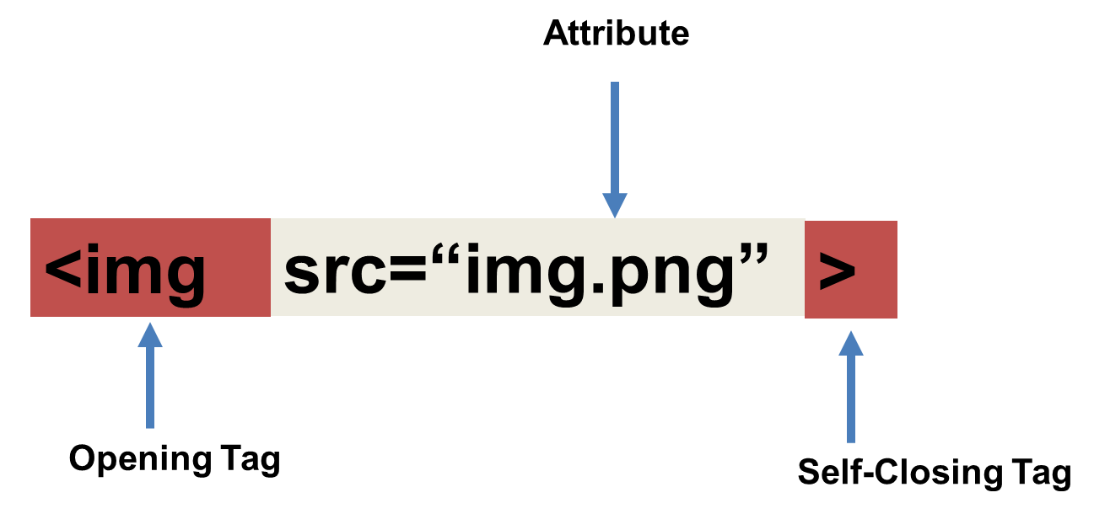
Tricky Tags (Self-Closing)

Slide 45
Important Common Tags
Headings:
<h1> </h1> - Heading 1 (Largest Heading)
<h2> </h2> - Heading 2 (Next Largest Heading)
<h3> </h3> - Heading 3
…
Containers:
<html> </html> - Wraps the entire page
<head> </head> - Wraps the header of the page
<body> </body> - Wraps the main content
<div> </div> - Logical Container ***
<p> </p> - Wraps individual Paragraphs
Others:
<strong> (bold), <em> (emphasis)
<img> (images), <a href> (links), <li> (list items) , <title> (title), <br> (line break), <table> (tables), <!-- --> (comments)

Slide 46
Less Common Tags
All HTML Tags are listed here: http://www.w3schools.com/tags/
Don’t try to memorize them! Simply refer back to documentation as needed.
Other tags:
<video> for Videos
<audio> for Audio files
<embed> for Embedded files
<code> for including computer code
<header> for headers
<nav> for navigation bars
<footer> for footers

Slide 47
HTML for Forms
Common UI (User Interface) Form Elements:
<form> - Creates a form section in HTML
<input> - Input boxes
<label> - Labels for boxes
<button> - Button
<textarea> - Large textbox

Slide 48
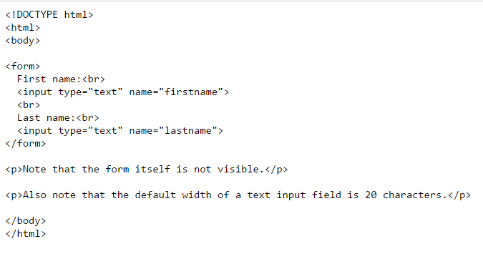
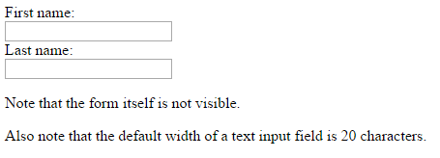
HTML for Forms

Slide 49
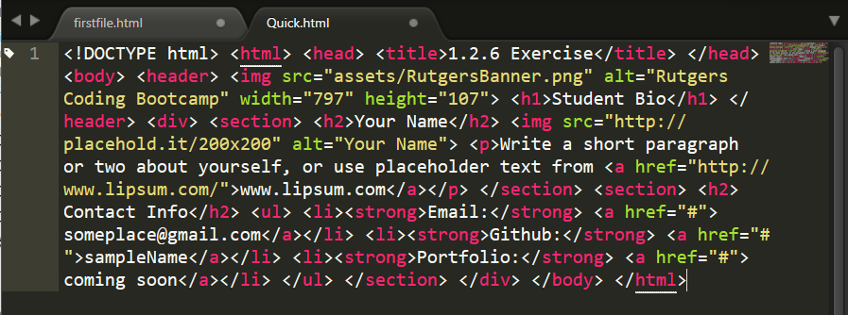
On Ugly HTML
Don’t do this… Use proper indentation and sectioning.
Readable code is easier to maintain.
Invest time to get better about this now. It will pay dividends!

Slide 50
> YOUR TURN!
Activity: 1.4 – HTML / Git | Suggested Time: 20 min
Assignment
In this activity, you’ll create a student bio using HTML. You will then add, commit, and push your completed HTML to GitHub for the world to see.
Additional instructions, sent via Slack.

Slide 51
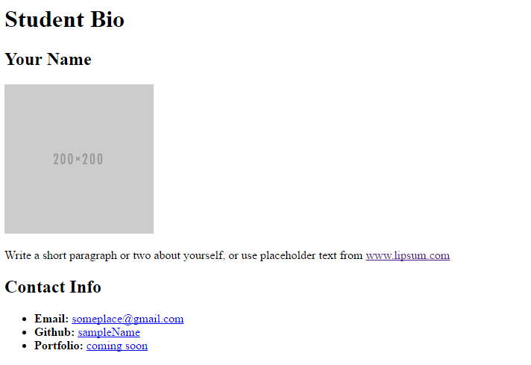
> YOUR TURN!

Slide 52
CSS Stylin’

Slide 53


HTML / CSS Definitions (*yawn* unimportant)
HTML: Hypertext Markup Language – (Content)
CSS: Cascading Style Sheets – (Appearance)
HTML/CSS are the “languages of the web.” Together they define both the content and the aesthetics of a webpage – handling everything from the layouts, colors, fonts and content placement. (JavaScript is the third – handling logic, animation, etc.)

Slide 54


HTML / CSS Analogy
HTML Alone
Like writing papers in “Notepad.”
Can only write unformatted text.
HTML / CSS
Like writing papers in Microsoft Word.
Can format text, page settings, alignment, etc. based on “highlighting” and menu options.

Slide 55
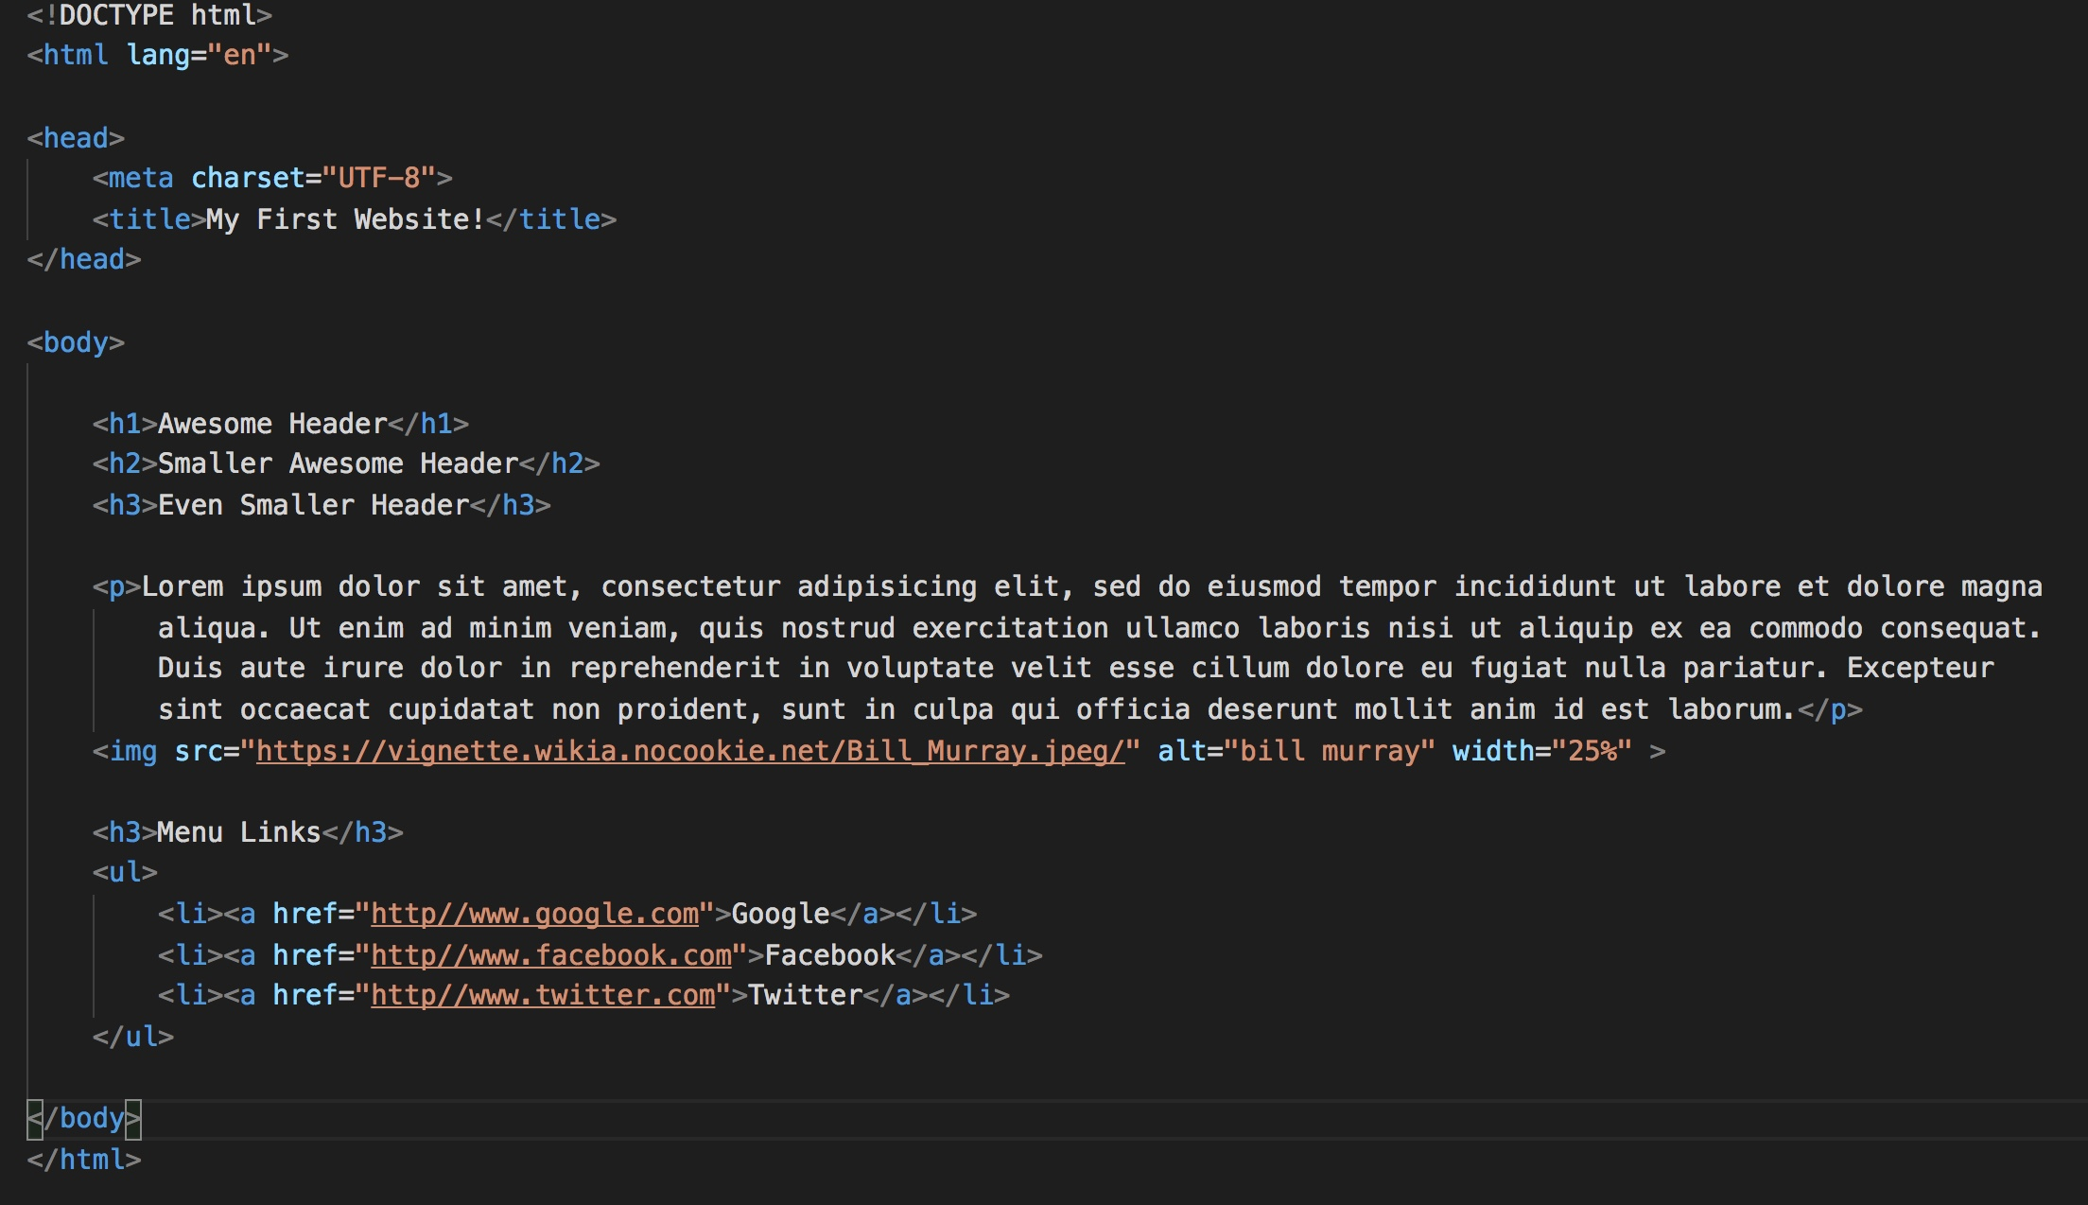
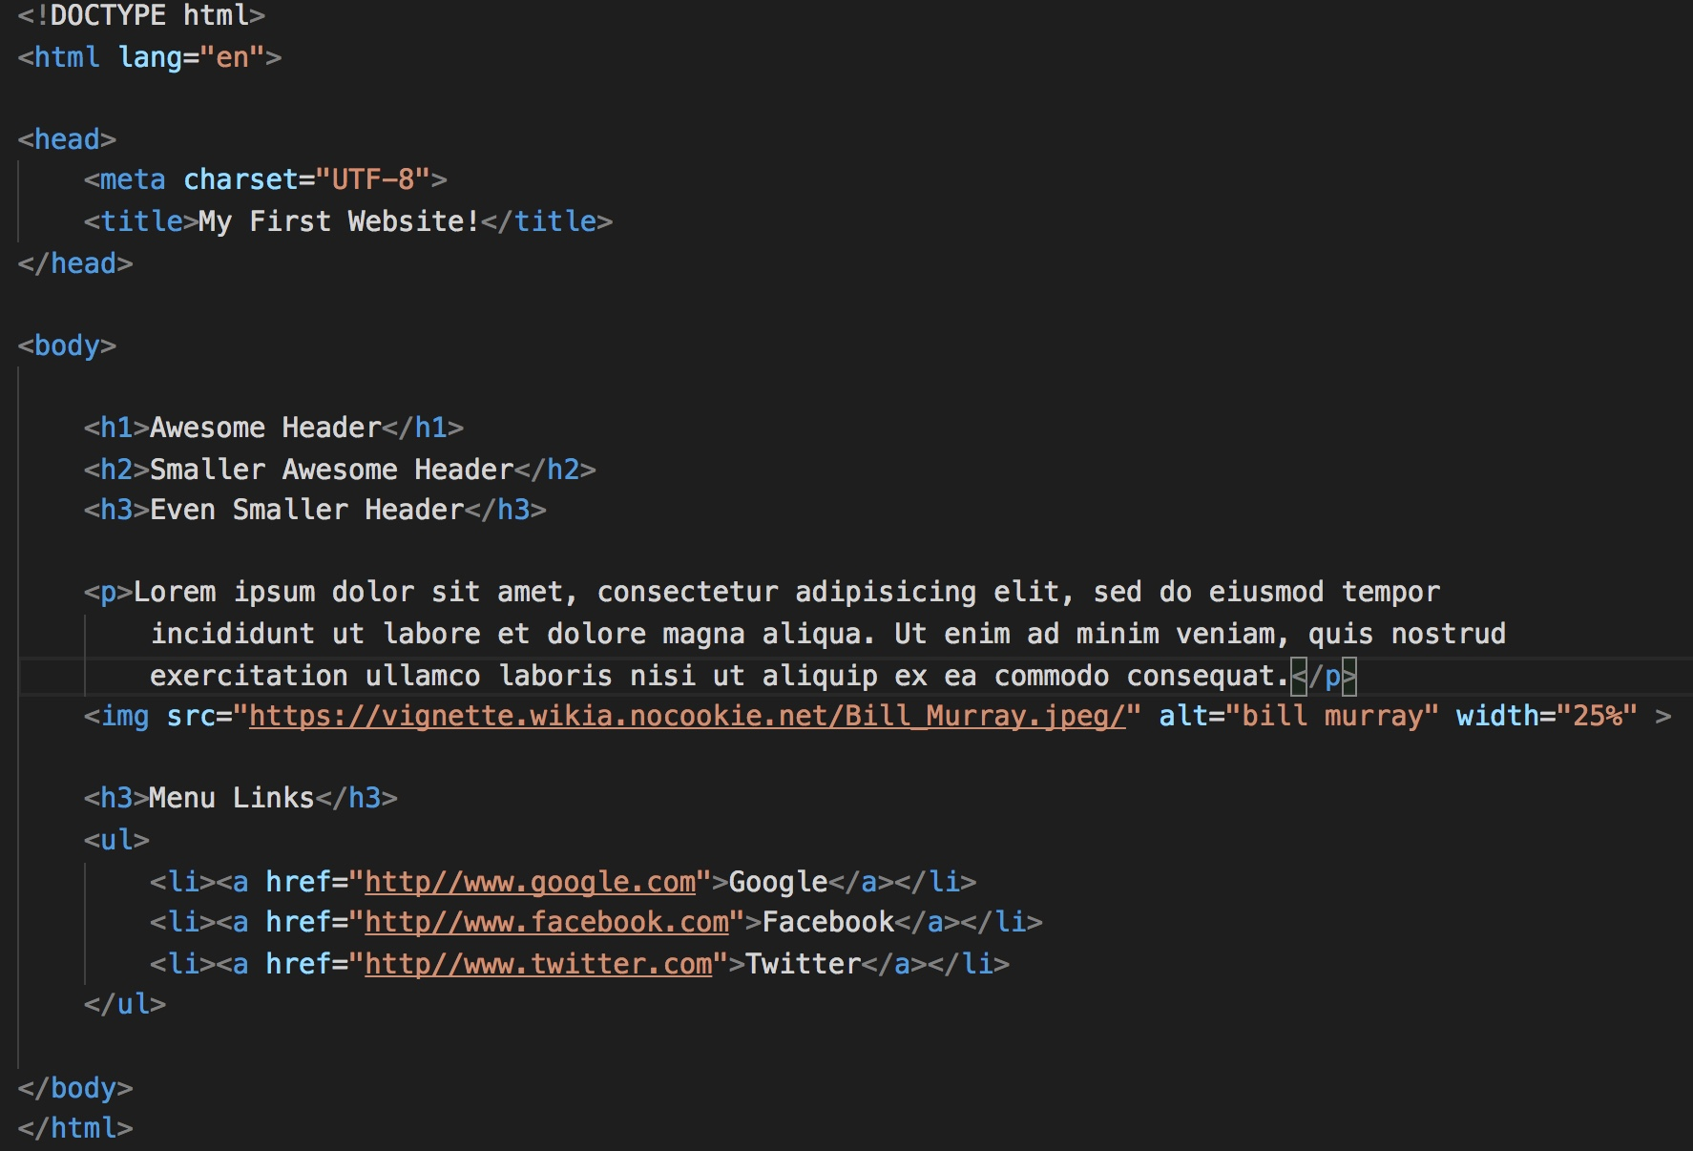
Basic HTML Page

Slide 56

Basic HTML Page - Result

Slide 57
Basic HTML Page - Result
Hella Boring…

Slide 58
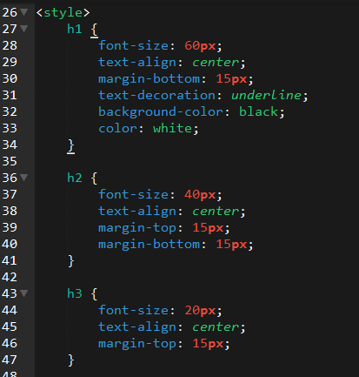
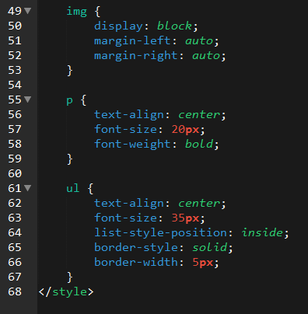
Enter CSS

Slide 59

Enter CSS - Result

Slide 60

CSS Syntax
CSS works by hooking onto selectors added into HTML using classes and identifiers.
Once hooked, we apply styles to those HTML elements using CSS.

Slide 61
CSS Example
In the below example the “Header” would be turned blue
and MUCH larger because of the CSS.
We can incorporate an element’s class or ID to apply a CSS style to a particular part of the document.
Just remember to include the necessary symbol before the CSS: “.” for class, “#” for ID.
Example (HTML):
<p class=“bigBlue”>Header</p>
Example (CSS):
.bigBlue
{
font-size: 100px;
color: blue;
}

Slide 62
Key CSS Attributes
Font / Color:
color: Sets color of text.
font-size: Sets size of the font.
font-style: Sets italics.
font-weight: Sets bold.
Alignment / Spacing:
padding (top/right/bottom/left): Adds space between element and its own border.
margin (top/right/bottom/left): Adds space between element and surrounding elements.
float: Forces elements to the sides, centers, or tops.
Background:
background-color: sets background color.
background-image: sets background image.

Slide 63
Powerful Duo
Believe it or not, HTML / CSS is all you need
to develop a vivid, full-blown website.

Slide 64
INSTRUCTOR DEMO
Instructor: Demo
(In-Class > 1.5 > quick-example-internal-css.html)

Slide 65
> YOUR TURN!
Activity: 1.6 – HTML / CSS Layout | Suggested Time: 20 min
Assignment
In this activity, you’ll upgrade your previous HTML bio-page using CSS style rules. Once you’re done, commit and push up your changes to GitHub.
We’ll send you additional instructions via Slack.

Slide 66
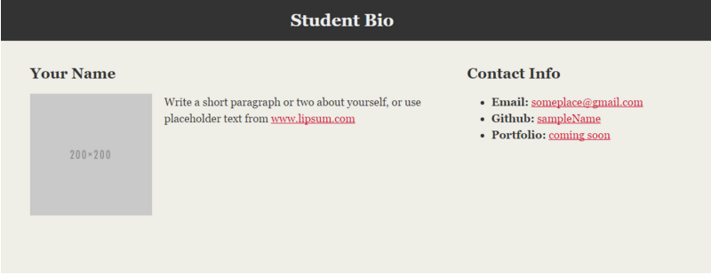
> YOUR TURN!

Slide 67
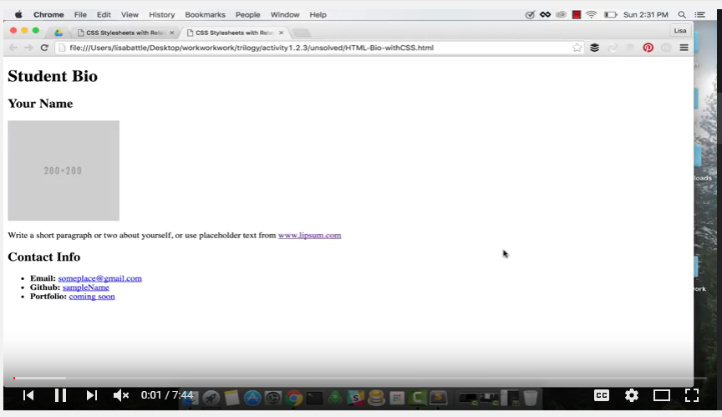
Video Walkthrough!!
https://www.youtube.com/watch?v=kMBinXTCrXI

Slide 68
Still a Bit Confused?
Remember! We’ve got video guides for key activities like that last one.
If you feel like you are EVER falling behind, use those online walkthroughs to help catch back up. They are made to be easy to understand.
Still having trouble? Shoot your instructor or one of your TAs a message!
We are here to help you out in whatever way we can!

Slide 69
Recap + Questions

